Slide 1

Student Performance Factor Analysis

Slide 2
Targeted Audience: Ministry of Education(MOE) Nepal
Motivation: To help the Ministry of Education (MOE) draft and implement targeted policies that address barriers to academic success, enabling equitable learning opportunities and fostering improved student performance nationwide.
By understanding key predictors of academic achievement, this analysis aims to empower data-driven decision-making for impactful education reforms

Slide 3

Problem Definition
Challenge: Despite significant investments in education, disparities in student performance persist, influenced by socio-economic, environmental, and individual factors.
Key Question: What are the most significant factors impacting student exam scores, and how can this insights guide effective interventions?
Objective: To identify and quantify the influence of variables such as attendance, Hours Studies, access to resources, learning disabilities, and parental involvement on academic performance.

Slide 4

Dataset Overview
6607 records and 20 columns
7 numerical and 13 categorical columns
Exam Score being target variable
Generated from schools in Nepal to gain insight in its education system

Slide 5
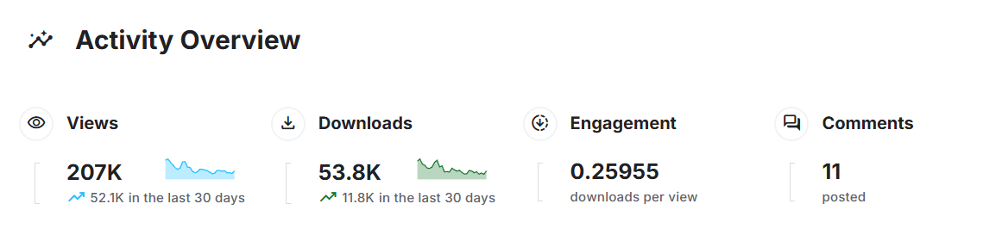
Related Works
Various individuals have worked on the dataset with more than 50,000 downloads in last month itself
Initial data information’s and dataset background were gathered from the Kaggle
Initial EDA’s idea were gathered from the work of authors in Kaggle (included in references)

Slide 6

Data Preparation-I
Missing Values: three categorical columns Teacher Quality, Parental Education Level and Distance from Home had missing values.
It was replaced with the mode of the given column
Dataset mostly clean and standardized with no missing values or no unexpected results

Slide 7

Data Preparation-II Machine Learning
Divided data into Training set (80%) and Testing Set(20%)
Applied LabelEncoder to convert categorical variables into numeric codes.
We transformed it into a binary classification problem where students were categorized as 1 (above median score) or 0 (below median score).
Applied StandardScaler to normalize numerical features to have a mean of 0 and a standard deviation of 1

Slide 8
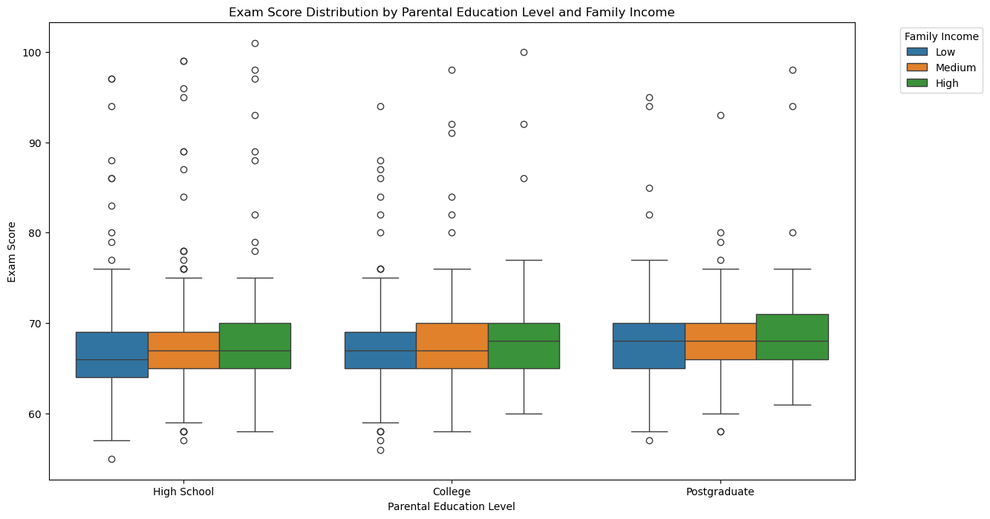
Exploratory Data Analysis: Key findings and Relationships

Slide 9
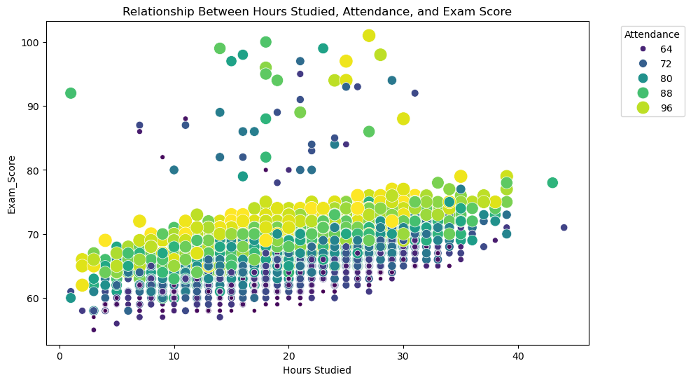

Slide 10
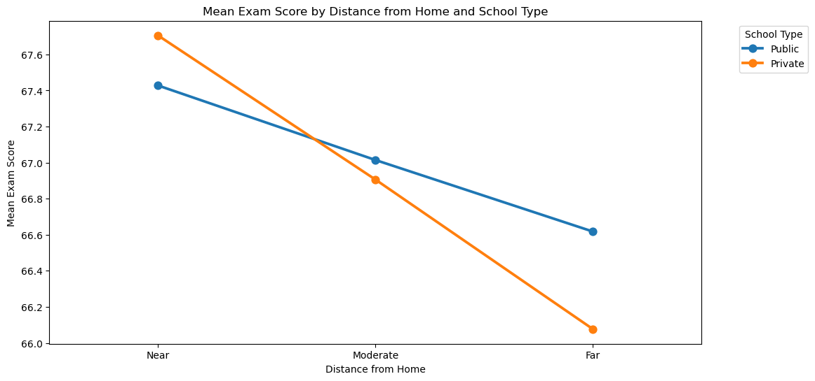

Slide 11
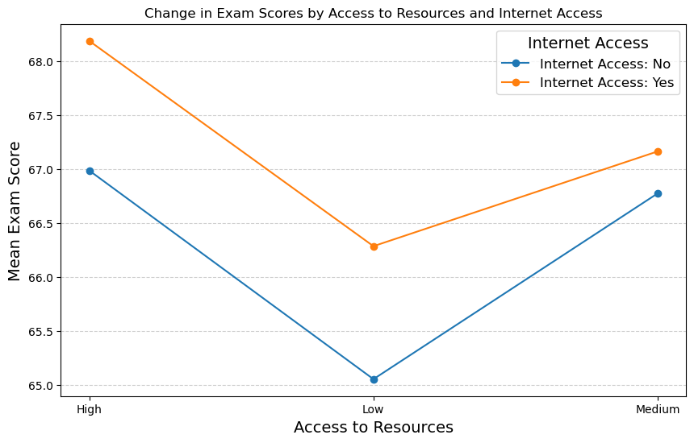

Slide 12
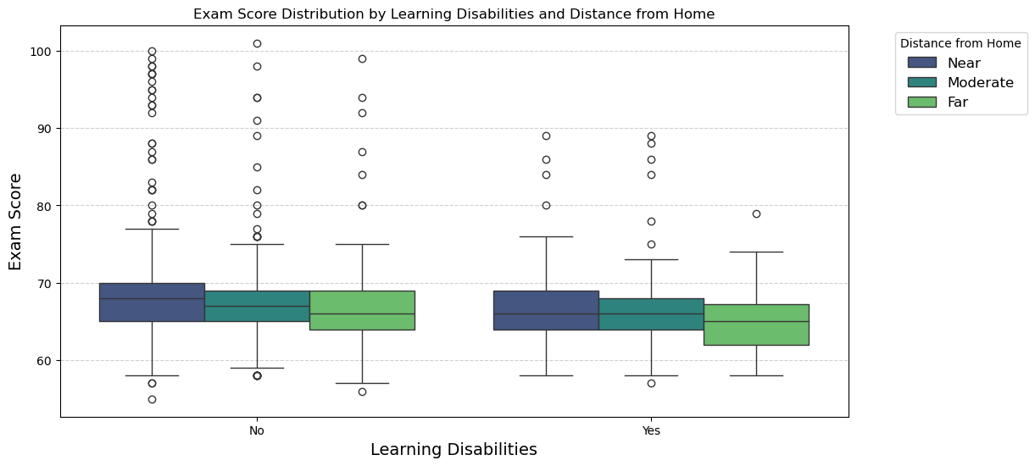

Slide 13

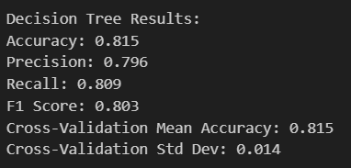
Decision Tree
Used Decision Tree Classifier to predict whether students scored above or below the median exam score.
Evaluated the model using 10-fold cross-validation to assess performance on unseen data.
High accuracy achieved as model predicted 81.5% of correct Exam score on the test data

Slide 14
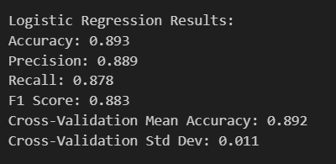
Linear Regression
Linear regression revealed a robust relationship between student performance and socio-economic factors, achieving an impressive accuracy of 89.3% in predicting exam scores.
The model’s high F1 score of 88.3% highlights its balanced ability to identify both high and low performers effectively, making it a valuable tool for analyzing education outcomes.
With a consistent cross-validation accuracy of 89.2% and minimal variability, linear regression demonstrated reliability and generalizability in uncovering insights from our dataset.

Slide 15

Recommendations - I
Make education accessible to all. Increase financial assistance to institutions and lower tuition fee.
Make educational infrastructure more accessible for student with disabilities.
Make internet available in all public libraries and educational institutes

Slide 16

Recommendations-II
Equip educational institutes with latest computers, books and educational materials.
Conduct inter-school competitions and introduce rewards to boost student motivation
Regular workshop with parents to train them to properly guide the children and motivate them.

Slide 17
References
Me, P. D. A. W. (2024, November 10). Student performance factors. Kaggle. https://www.kaggle.com/datasets/lainguyn123/student-performance-factors/code
Iwways. (2024, November 16). Student performance factors eda. Kaggle. https://www.kaggle.com/code/iwways/student-performance-factors-eda
Andriipysarevskyi. (2024, October 24). Students performance analysis. Kaggle. https://www.kaggle.com/code/andriipysarevskyi/students-performance-analysis
Ibm. (2024, August 15). What is a decision tree?. IBM. https://www.ibm.com/topics/decision-trees
W3schools.com. Python Machine Learning Linear Regression. (n.d.). https://www.w3schools.com/python/python_ml_linear_regression.asp

